Slide 1
A Deep dive into FidelityFX Super Resolution 2
Dihara Wijetunga
Senior Software Development Engineer, AMD

Slide 2
Agenda
Introduction to Upscaling
FSR 2 Overview
Algorithm step by step
FSR 2 API
Runtime
Integration Process
What’s new in FSR 2.1
Conclusion

Slide 3
Why upscaling?
Upscaling: the process to produce high-resolution frames from low-resolution inputs
Enables large performance improvement compared to native rendering
Required due to
High-quality visual features in games such as HW ray tracing
Higher frame rates on low end GPUs
FSR* 1.0 is a spatial-only upscaler and has been our most adopted effect to date
*See end note GD-187
Super Resolution
Low resolution render
Super resolution output

Slide 4
fidelityfx super resolution 2
FSR 2 is a temporal upscaler
Uses more than one frame to produce an upscaled image
Addresses quality concerns of FSR 1.0 solution – significantly higher quality
Open-Source technology, increasingly adopted by game developers
Multiple titles already shipped
And more…

Slide 5
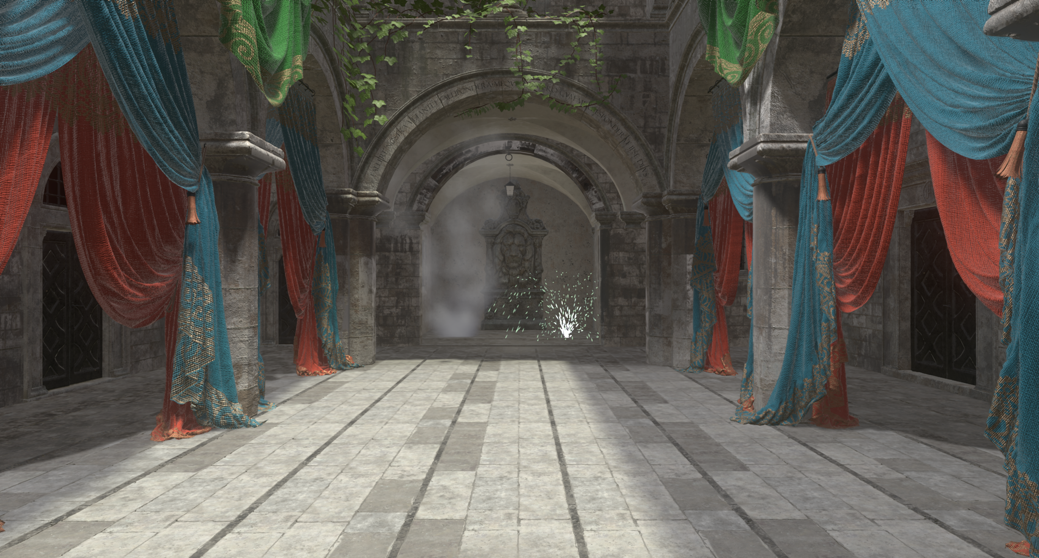
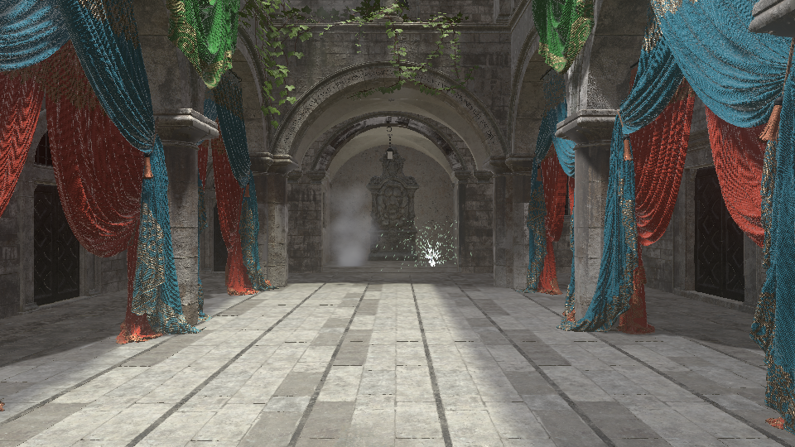
Algorithm step by step

Slide 6
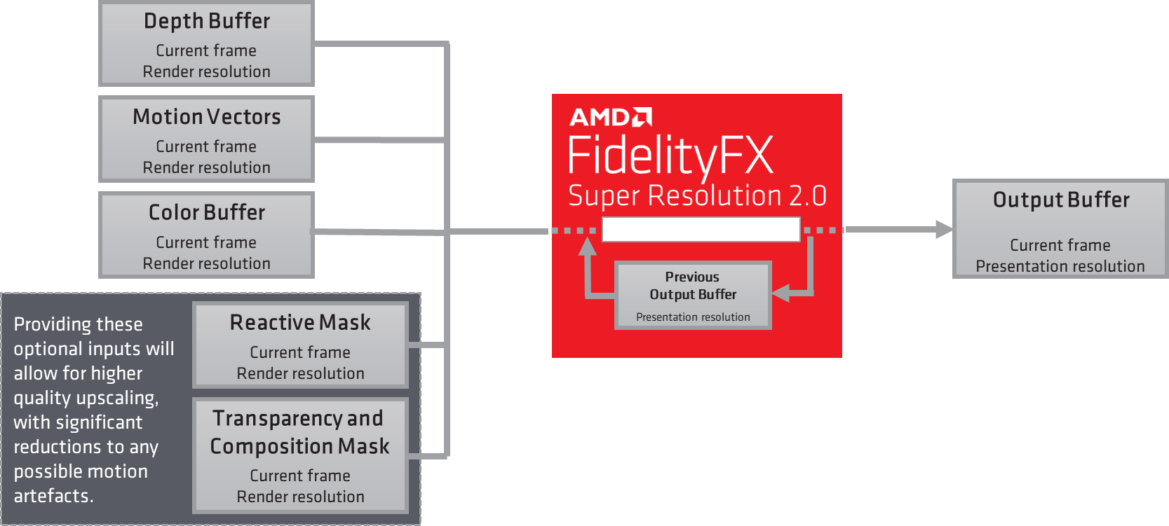

Slide 7
Building up on temporal anti-aliasing
TAA consists of sample aggregation at the rendered pixel level Aggregation of more samples will increase antialiasing quality

Slide 8
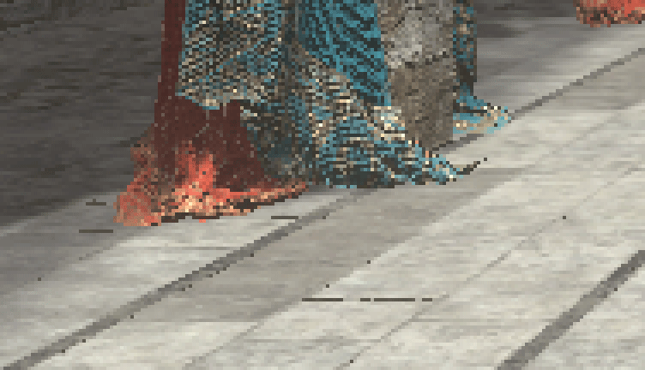
Building up on temporal anti-aliasing
Render resolution jittered samples. By jittered, we mean offset samples within the pixels
Jitter sequence quality is key to achieve good antialiasing/upscaling
Good distribution over space and time
We provide helper function to generate Halton (2,3) jitter offsets

Slide 9
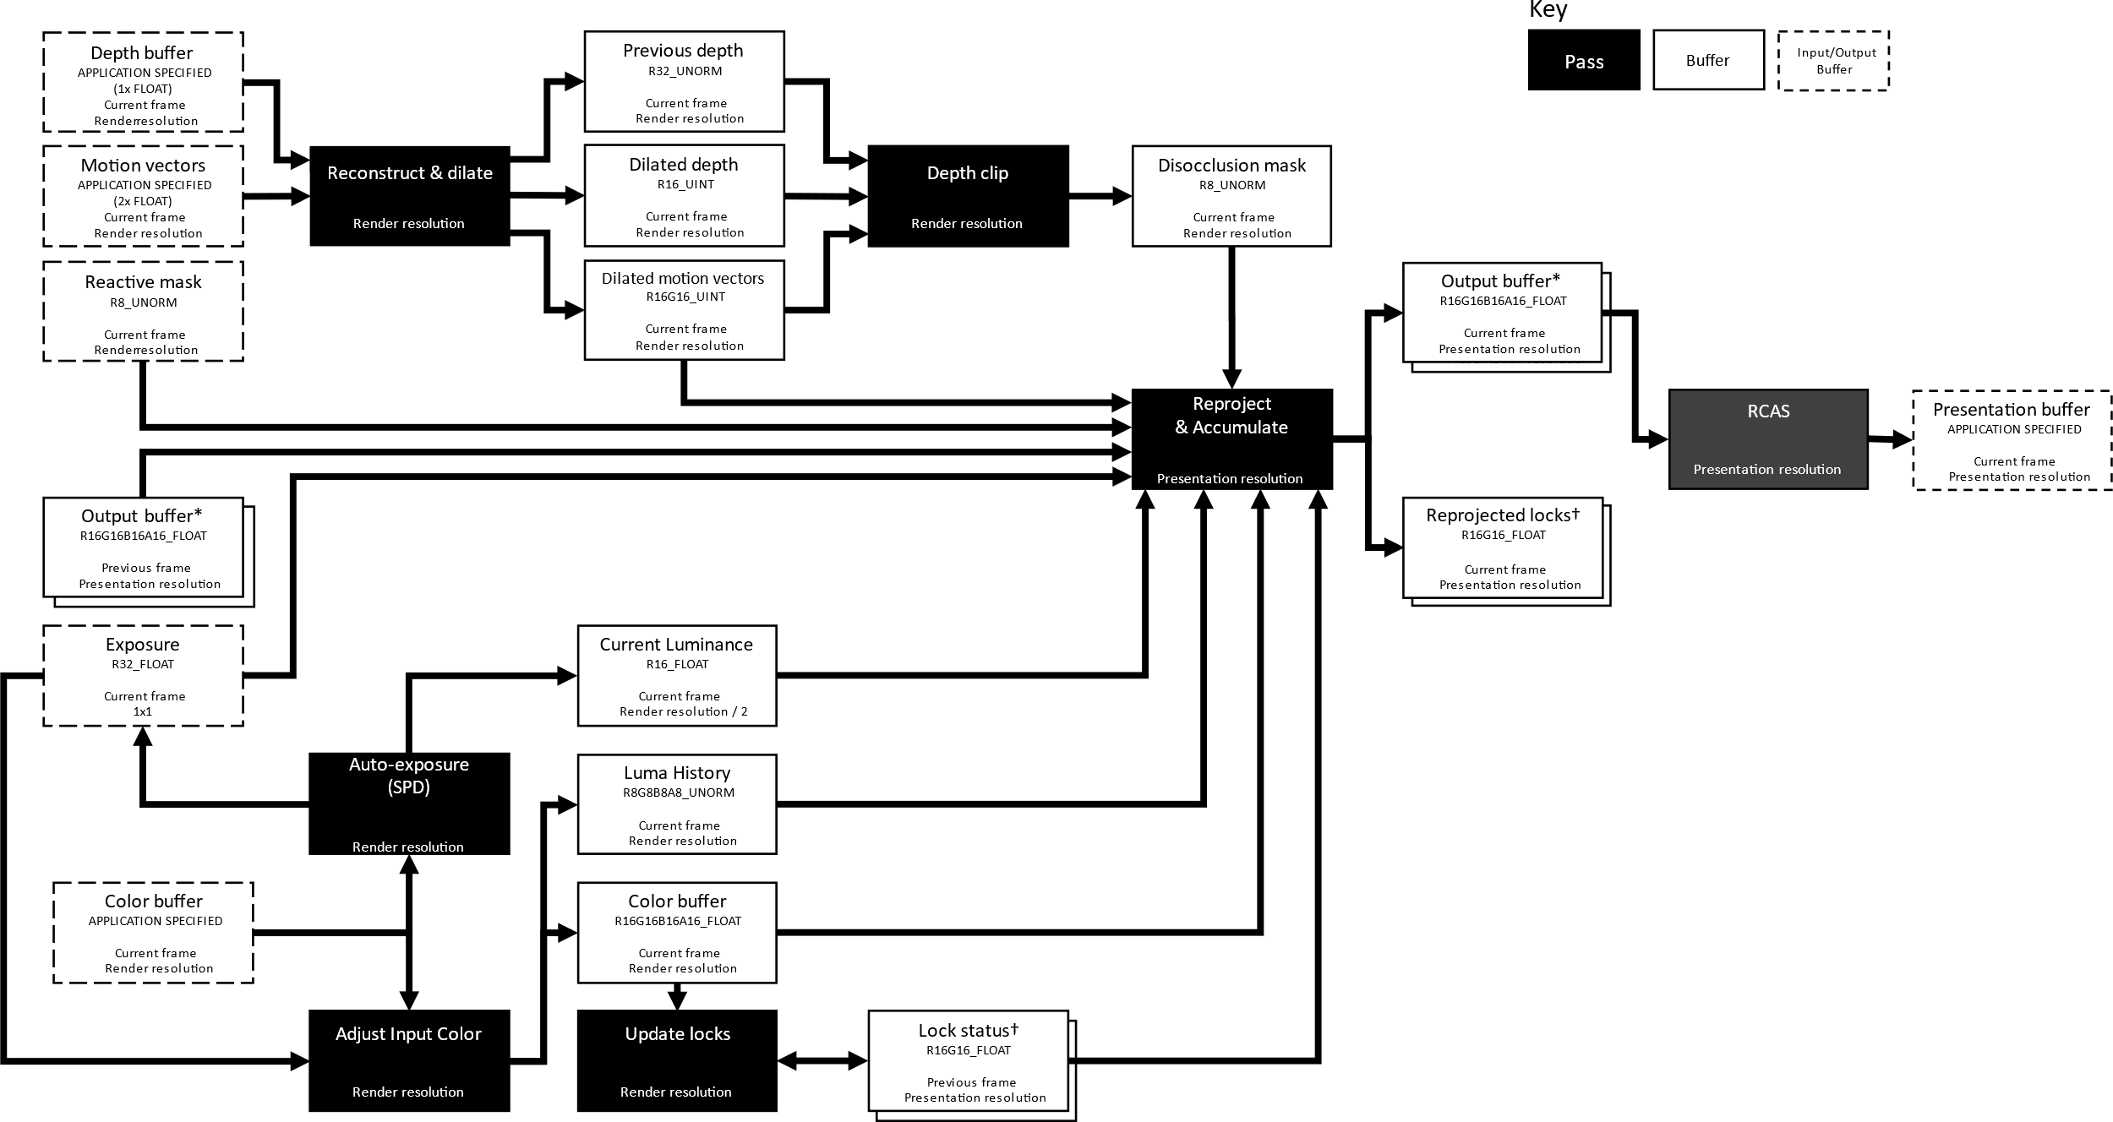

Slide 10
Compute LUMINANCE PYRAMID PASS
Generates low-resolution luminance of color buffer
Used for detecting shading changes
Exposure value
Used in subsequent stages if Auto Exposure flag is set

Slide 11
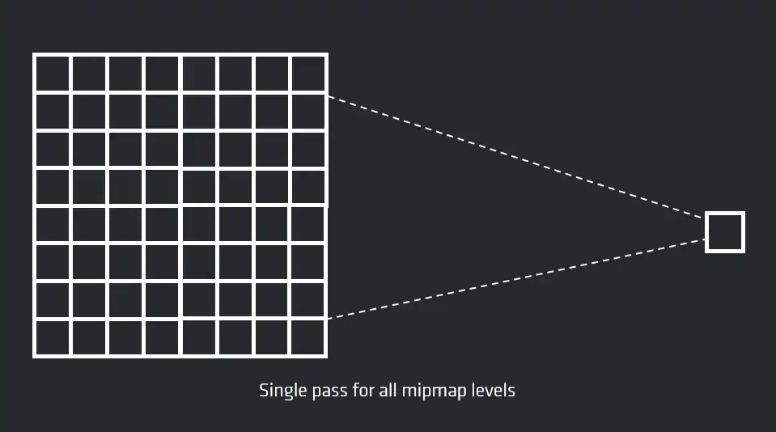
Compute LUMINANCE PYRAMID PASS
SPD – FidelityFX Single Pass Downsampler
Optimized compute shader for outputting multiple downsamples of an image

Slide 12
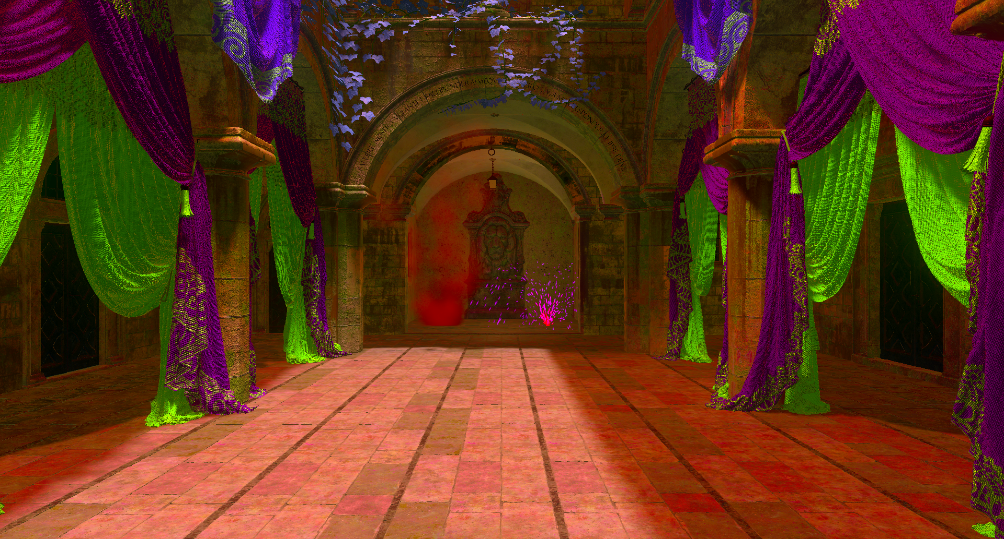
adjust input color PASS
Perform adjustments to input color
Divide by pre-exposure value
Multiply by exposure value
Convert to YCoCg color space
Color adjustments internal to FSR 2
Output in requested color space
Generates luminance history buffer
Stores luminance of the 3 most recent frames
Compute luminance stability value
Update luminance history

Slide 13
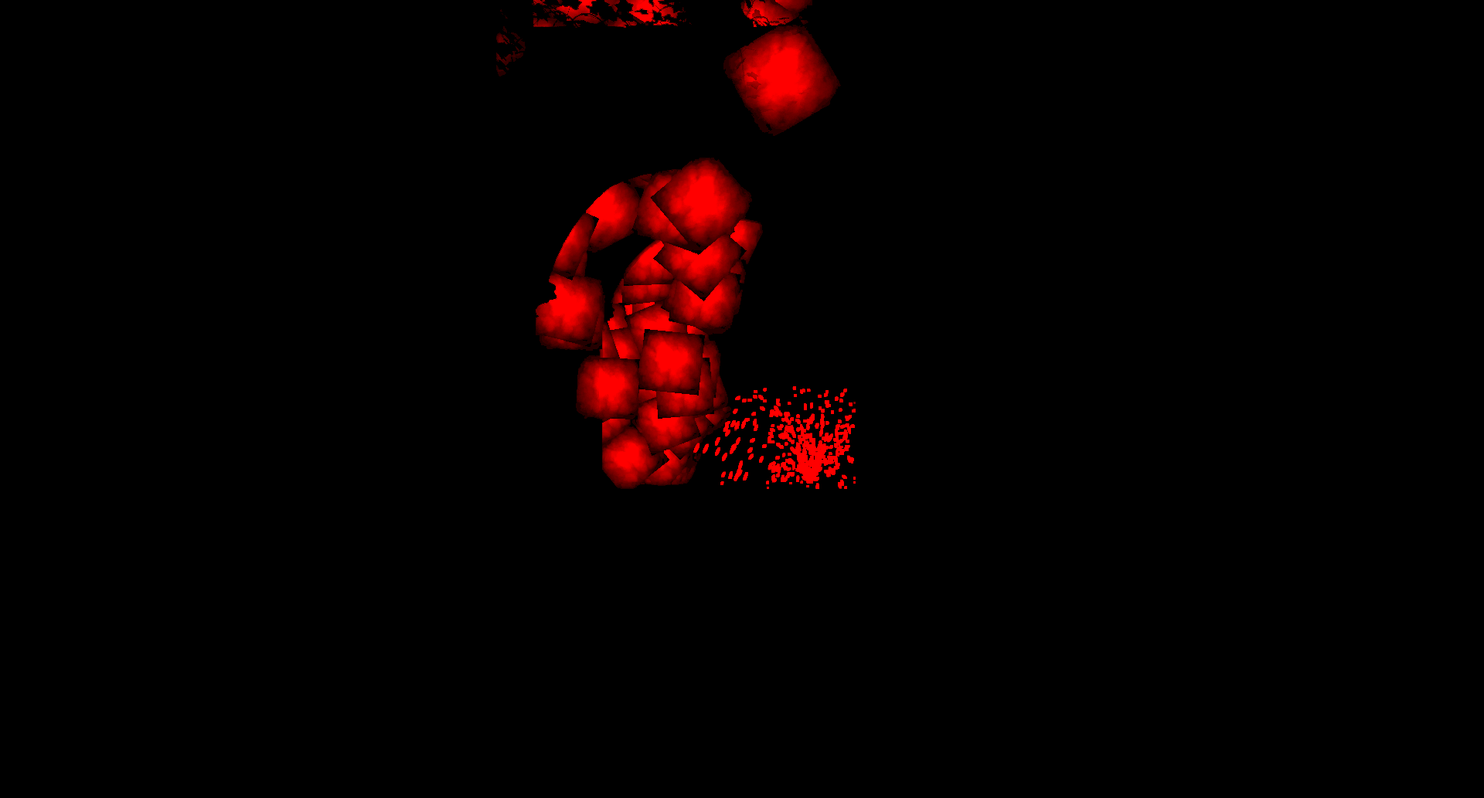
RECONSTRUCT AND DILATE PASS
Generate dilated depth, motion vectors and reactive mask values for the current frame
Estimate the position of each pixel in the current depth buffer in the previous frame

Slide 14
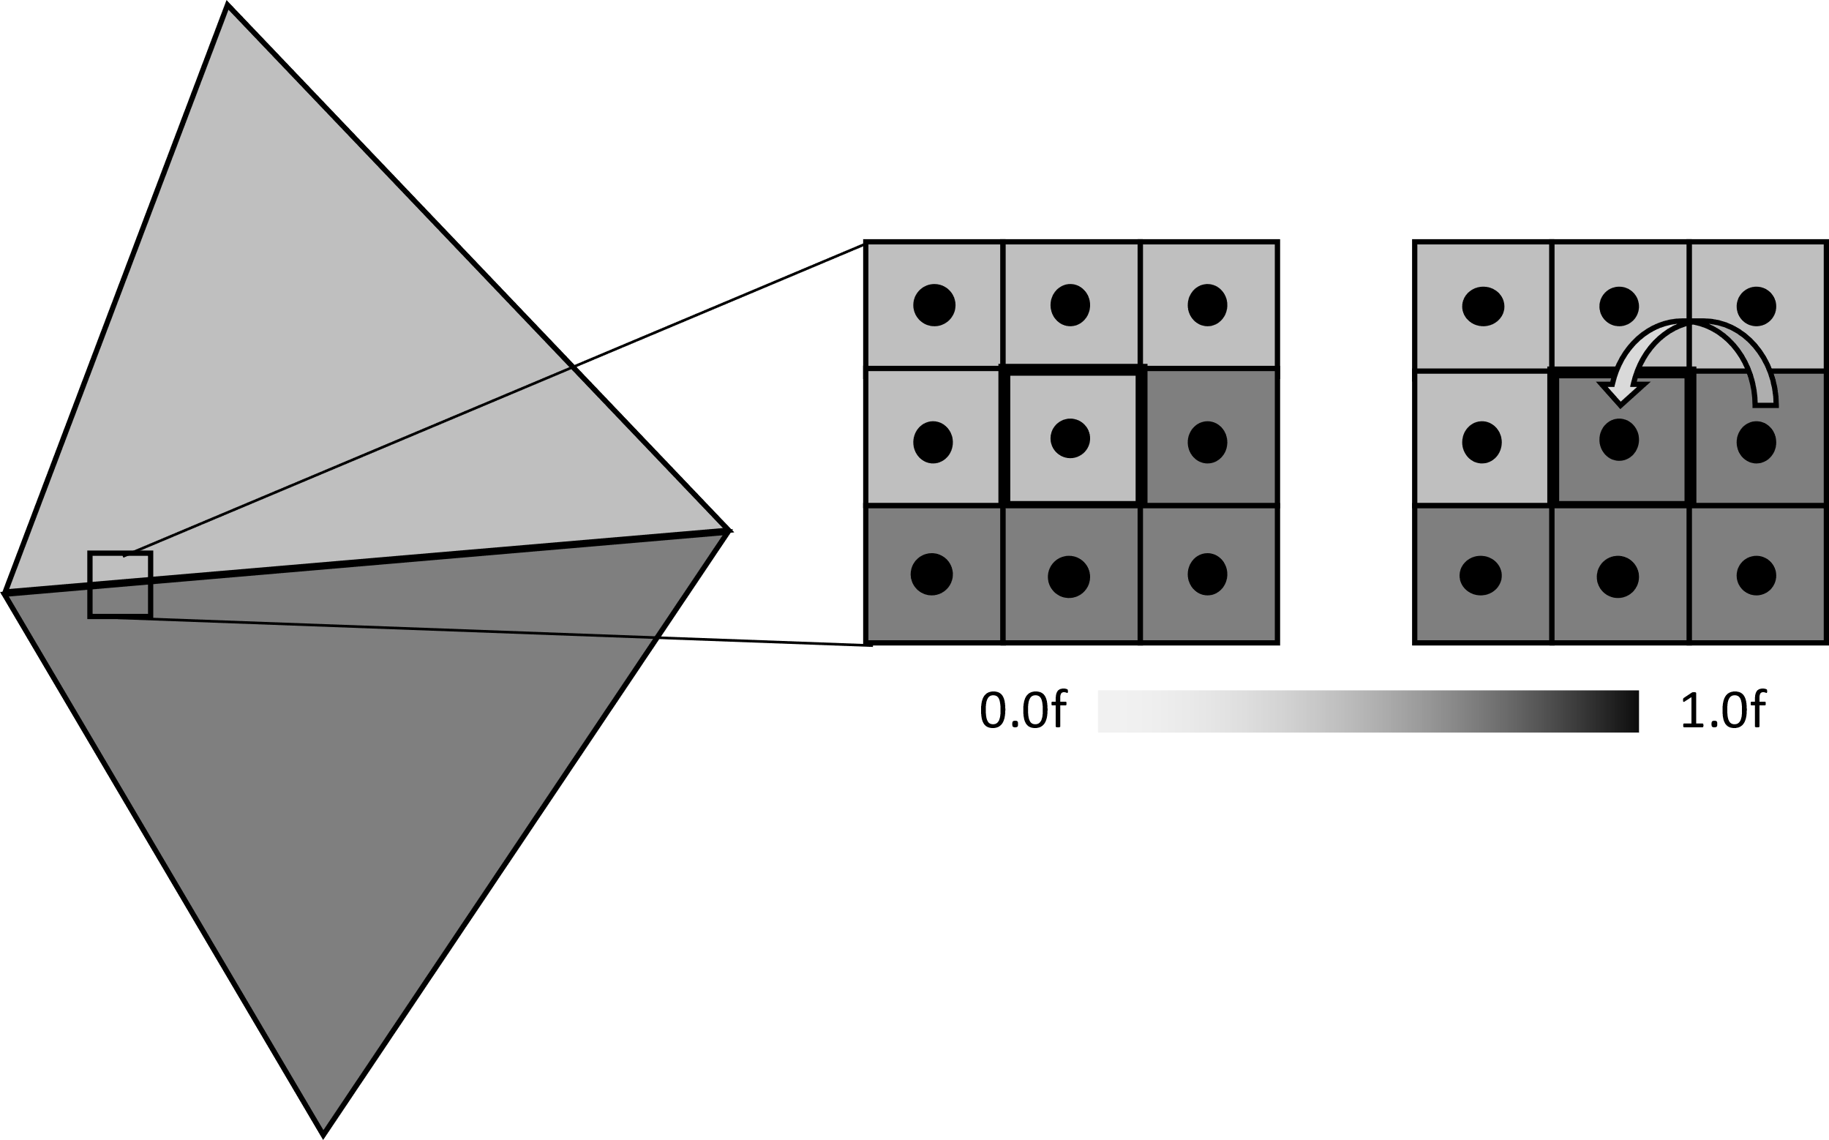
depth based dilation
To allow reprojection to better follow geometrical edges, render size motion vector resources are sampled based on depth buffer information
This is referred to as dilation
Use depth and motion vector in the location of the nearest depth sample location in 3x3 search area

Slide 15
color based dilation
Currently, reactive masks are dilated using color information
Spread center reactiveness to surrounding 3x3 area based on input color similarity
Input reactiveness
Input color
Dilated reactiveness

Slide 16
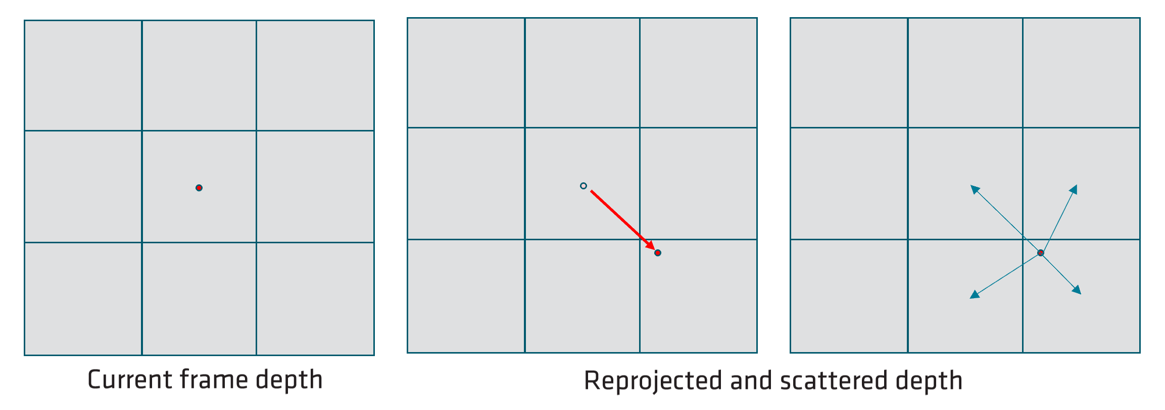
reconstruct previous depth
To detect disocclusions, we need the previous depth buffer
Each depth sample is reprojected to its location into the previous frame
The reprojected sample is scattered among all impacted samples (backward or reverse reprojection)
The nearest depth is kept using atomic comparisons when multiple samples hit the same location

Slide 17
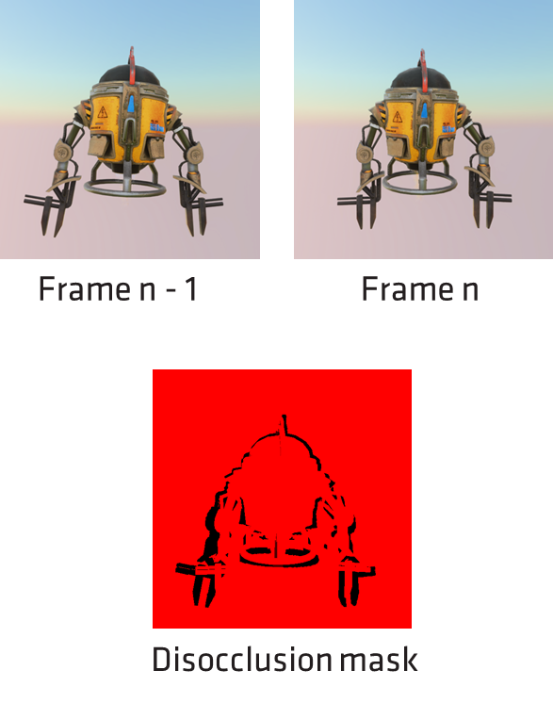
DEPTH CLIP PASS
Generates a 'Disocclusion Mask' using the Dilated depth and Reconstructed Previous frame depth
Let's look at the problem it solves...

Slide 18
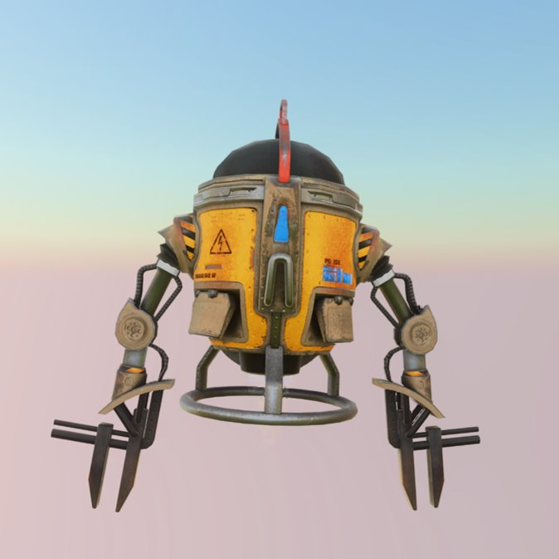
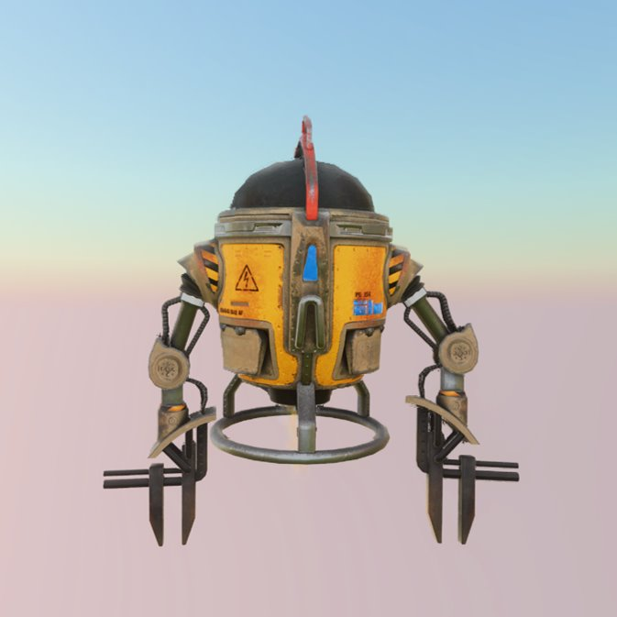
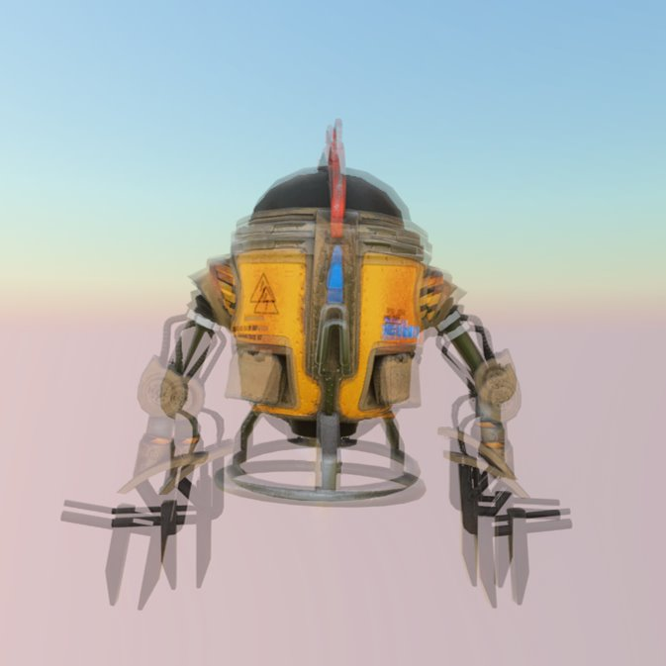
Motion vectors
A motion vector describes how a sample moved from the previous frame to the current one
Motion vectors must have jitter cancelled out as null vectors are expected on still
Frame n - 1
Frame n
Motion vectors

Slide 19
History reprojection
Previous frame color information needs to be reprojected into the actual incoming frame
Using motion vectors, we know where to look in the history data
Frame n - 1
Frame n
Motion vectors

Slide 20
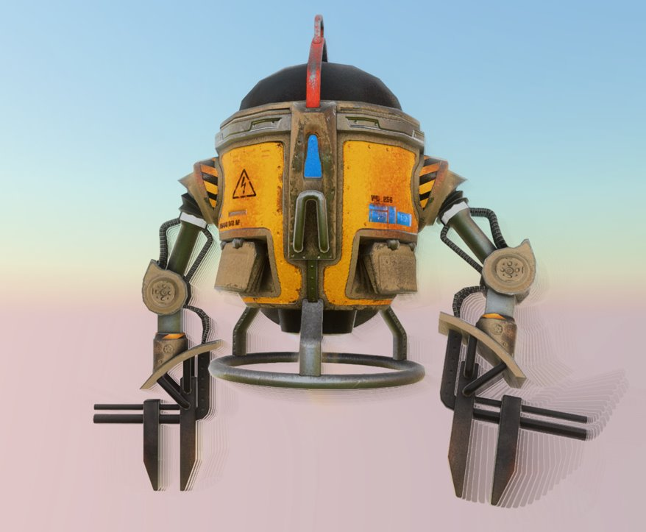
ghosting
There are cases where history data is not correlated anymore with the new input
Disocclusion
Shading change
Ghosting is seen when we don’t correctly handle those cases
Ghosting due to disocclusion is handled by a disocclusion mask

Slide 21
detect disocclusions
A disocclusion mask is created using
The dilated render resolution depth
The reconstructed previous frame depth
For each sample, its current depth is compared to the reconstructed previous depth at its previous location
Bilinear reprojection of the estimated previous depth, gives four disocclusion estimates per mask location
Disocclusion is estimated per pixel
previous depth – current depth > minimum depth separation
Minimum separation factor is computed using constant Ksep factor, view space depth, field of view and viewport size

Slide 22
Create LockS PASS
A pixel lock is a mechanism for stopping color rectification
Allows to preserve thin features such as wires or chain linked fences
The Lock Status buffer stores two values
Red: Remaining lifetime of a lock
Green: Luminance of the pixel at the time of locking

Slide 23
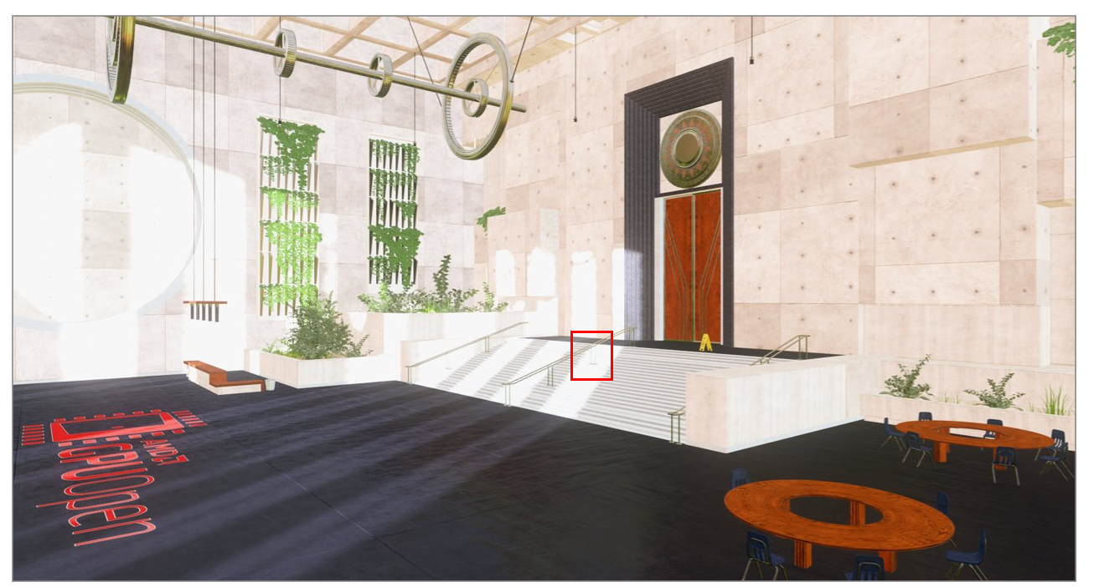
Thin features
Thin features are possibly only occurring for a few jittered samples over the overall sequence
Color rectification will take them down as soon as it is not part of the input image
This result in an unstable image, or some very dimmed features
We need to address this problem
Almost invisible and flickering thin feature

Slide 24
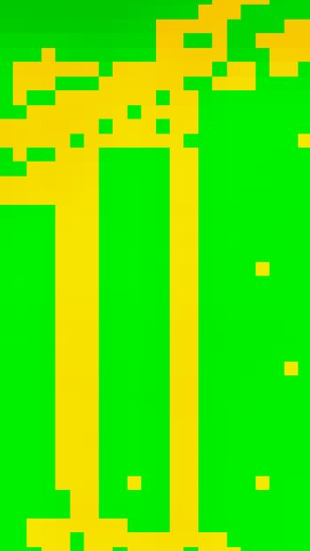
lock potential thin features
We detect pixel wide ridge patterns, within 3x3 area, as thin features and lock them
Detect in render resolution domain, lock in display resolution domain
Next time history color goes through rectification, its weight will be emphasized
It will not get clamped during color rectification
Almost invisible and flickering thin feature
Locked pixels
Stabilized thin feature

Slide 25
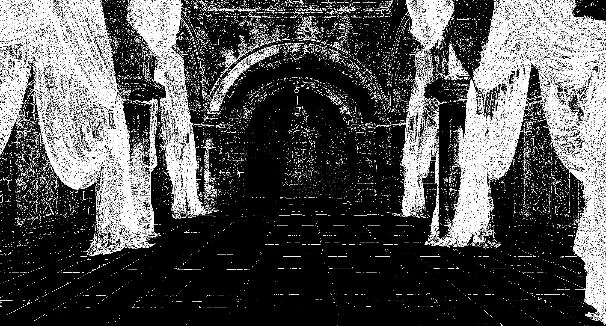

Slide 26
When to unlock?
When the scene moves, locks need to be updated
Moved with the rest of the scene
Kill if the thin feature disappear
Implicit lock killing will often be too slow
Leads to ghosting
Locks are killed or not trusted using
Disocclusion mask
Shading change detection (local, low frequency, luminance comparison)
Reactive masks

Slide 27
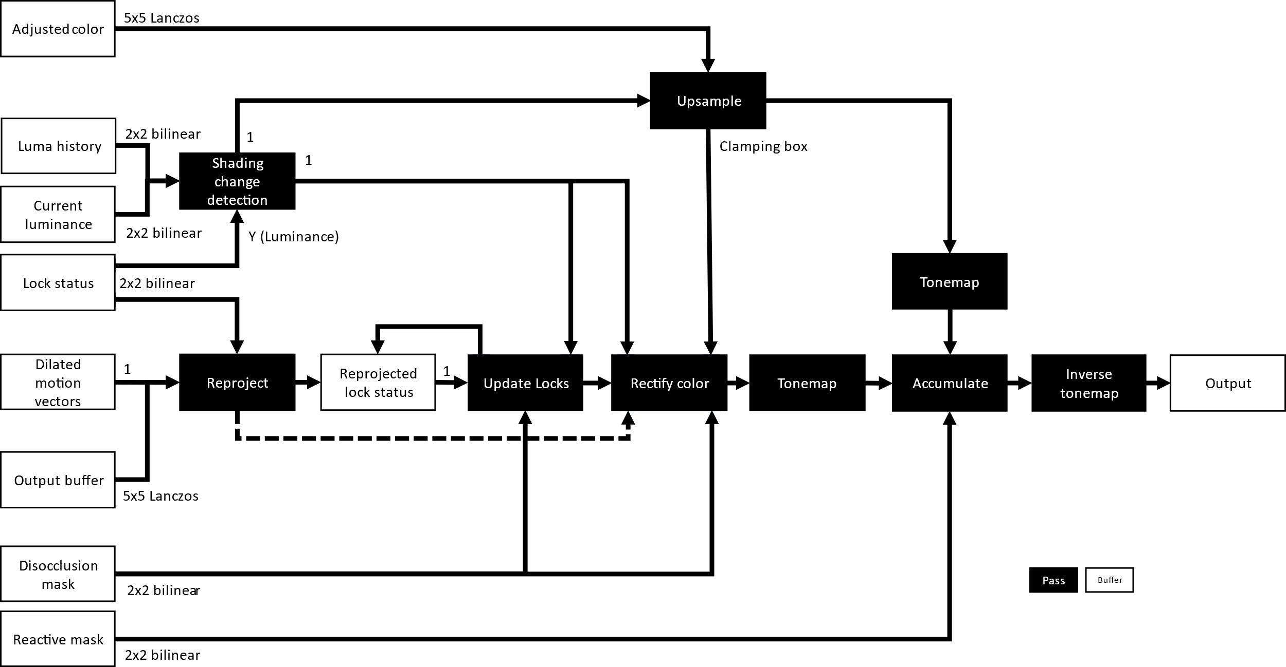
REPROJECT AND ACCUMULATE PASS

Slide 28
Shading Change Detection
If in a locked area
Luminance at the time of lock creation compared to shading change threshold
If in a non-locked area
Current frame and historical luminance values used to determine shading changes
Used in subsequent stages

Slide 29
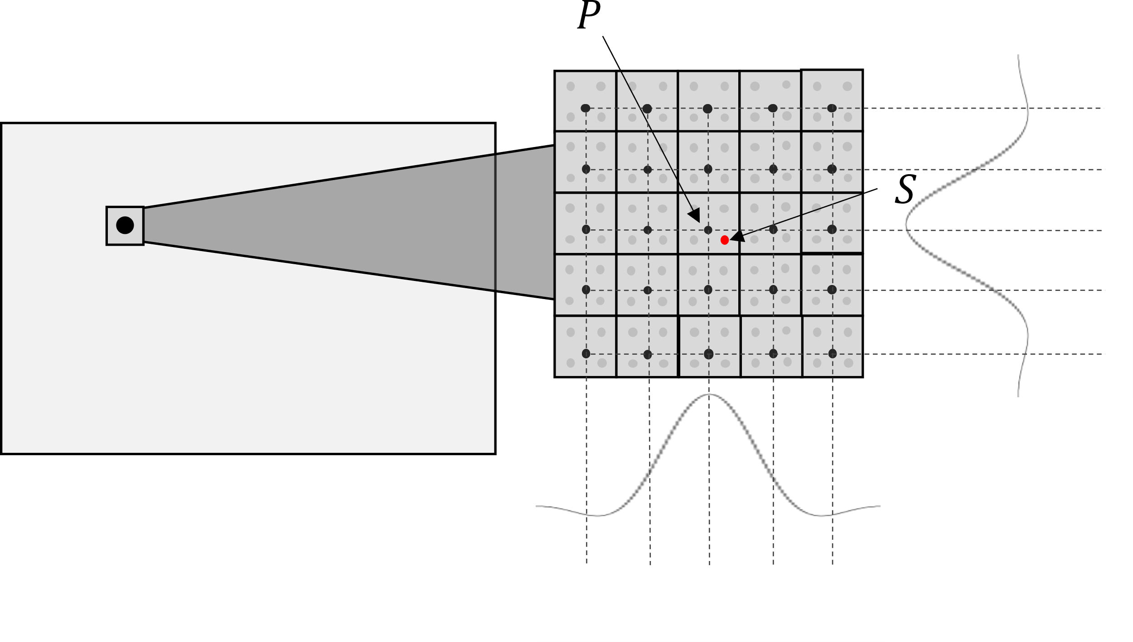
Upsampling
Adjusted input colors are resampled using a 5x5 Lanczos kernel
$S$ is the high-resolution sample to compute
$P$ is the set of low-resolution samples
Actual filter footprint of 4x4 due to skipping zero weighted contributions
$$ω_{P}=Lanczos(|PS|)$$
$$S=\sum_{P}{P∙ω_{P}}$$

Slide 30
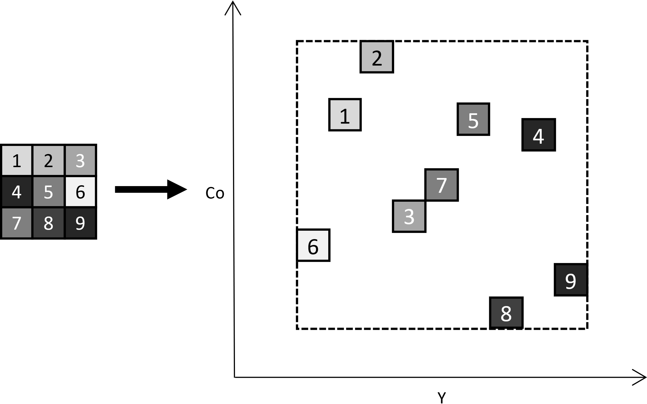
Upsampling
Samples already loaded
Compute YCoCg bounding box from 3x3 area
3-dimensional bounding box
Cg as third axis
Used in subsequent color rectification stage

Slide 31
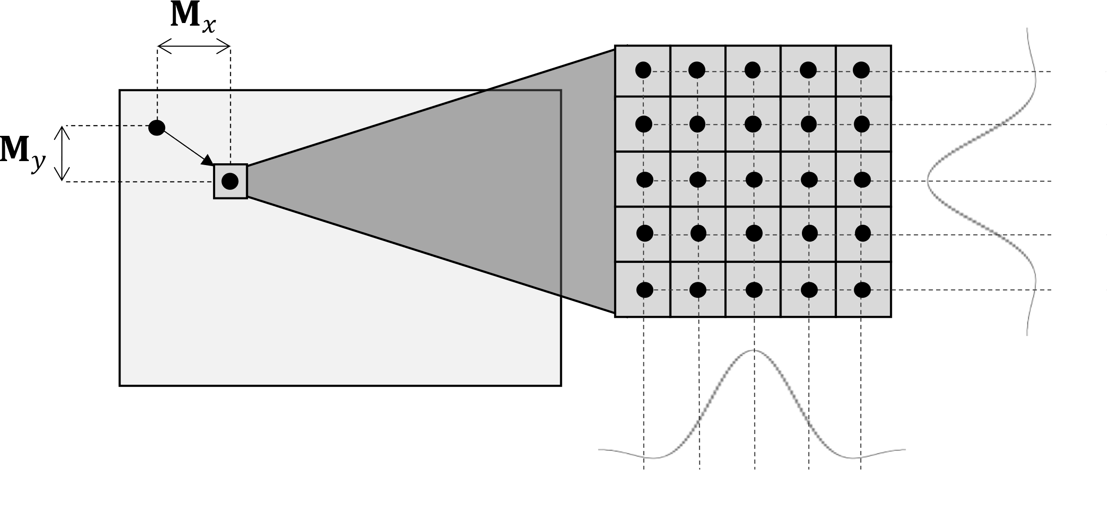
History reprojeciton
Using dilated motion vectors, history color and locks are reprojected
Resampled using Lanczos
Reprojected color values are re-aligned using the current frame exposure

Slide 32
Update Locks
Update locks created in this frame
Write current frame luminance to the green channel of Lock Status buffer
Determine lock trustworthiness
Compare luminance of surrounding pixels to current luminance
If lock is trustworthy, perform history rectification

Slide 33
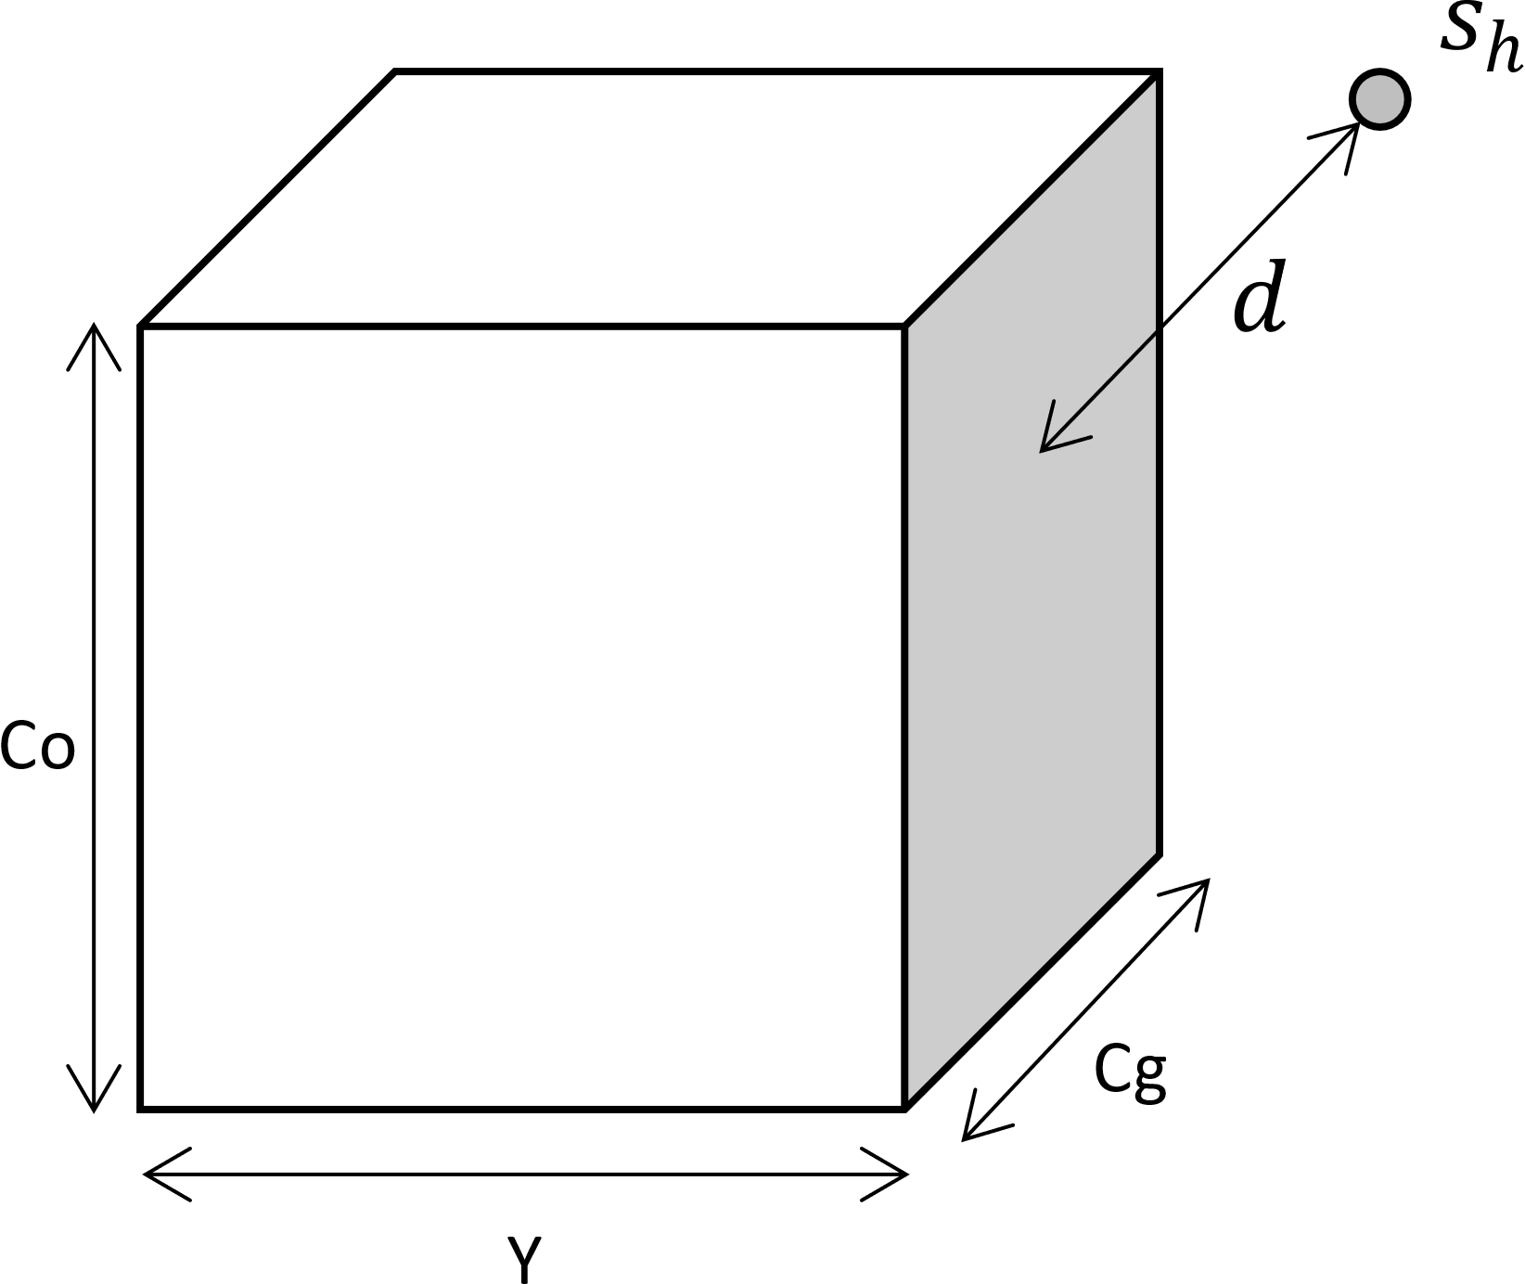
History rectification
Determine final history color
Reduce influence of samples from disoccluded areas
Using Disocclusion mask
Reduce influence of history samples outside the current frame color bounding box
Computed during upsampling

Slide 34
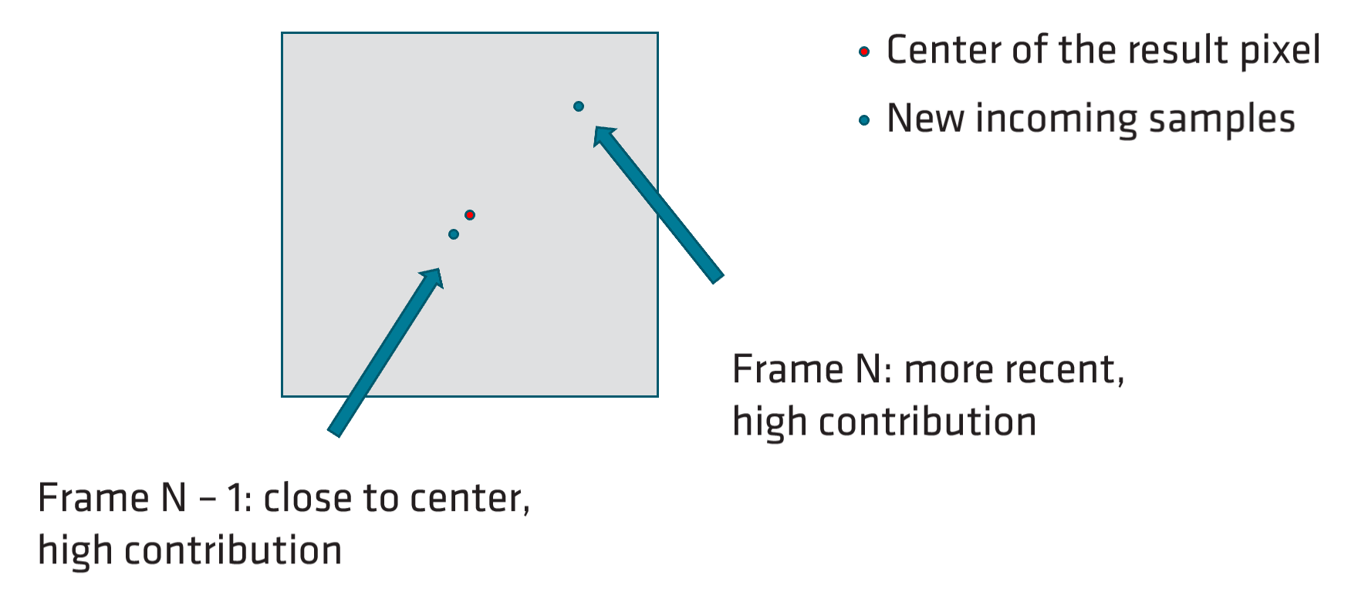
Accumulation
Blending upscaled color with rectified history color
$S$ is the new contributing sample
$H$is the already accumulated history samples
Each sample will have a different contribution to the new frame, depending on
Its spatial relevance to the actual target pixel
The already accumulated amount of information
$α$is the sample Lanczos weight $ω$ relative to the total accumulated weight $τ$ at this pixel
Artificially cap $τ$ to the number of expected contributing frames
Emphasizes new incoming samples
$$αS+\left(1 − α\right)H$$
$$α= \frac{ω}{τ}$$
$$τ= ω+ ω_{n −1}+ ω_{n−2}+ …+ ω_{0}$$

Slide 35
Reactiveness
How much influence samples from the current frame will have towards the upscaled image
For best results on fast-moving alpha-blended draws, accumulation must be more reactive
Cannot determine from color, depth or motion vectors
Requires explicit marking of such areas in the Reactive Mask for best quality
0 = Not reactive, 1 = Full reactive

Slide 36
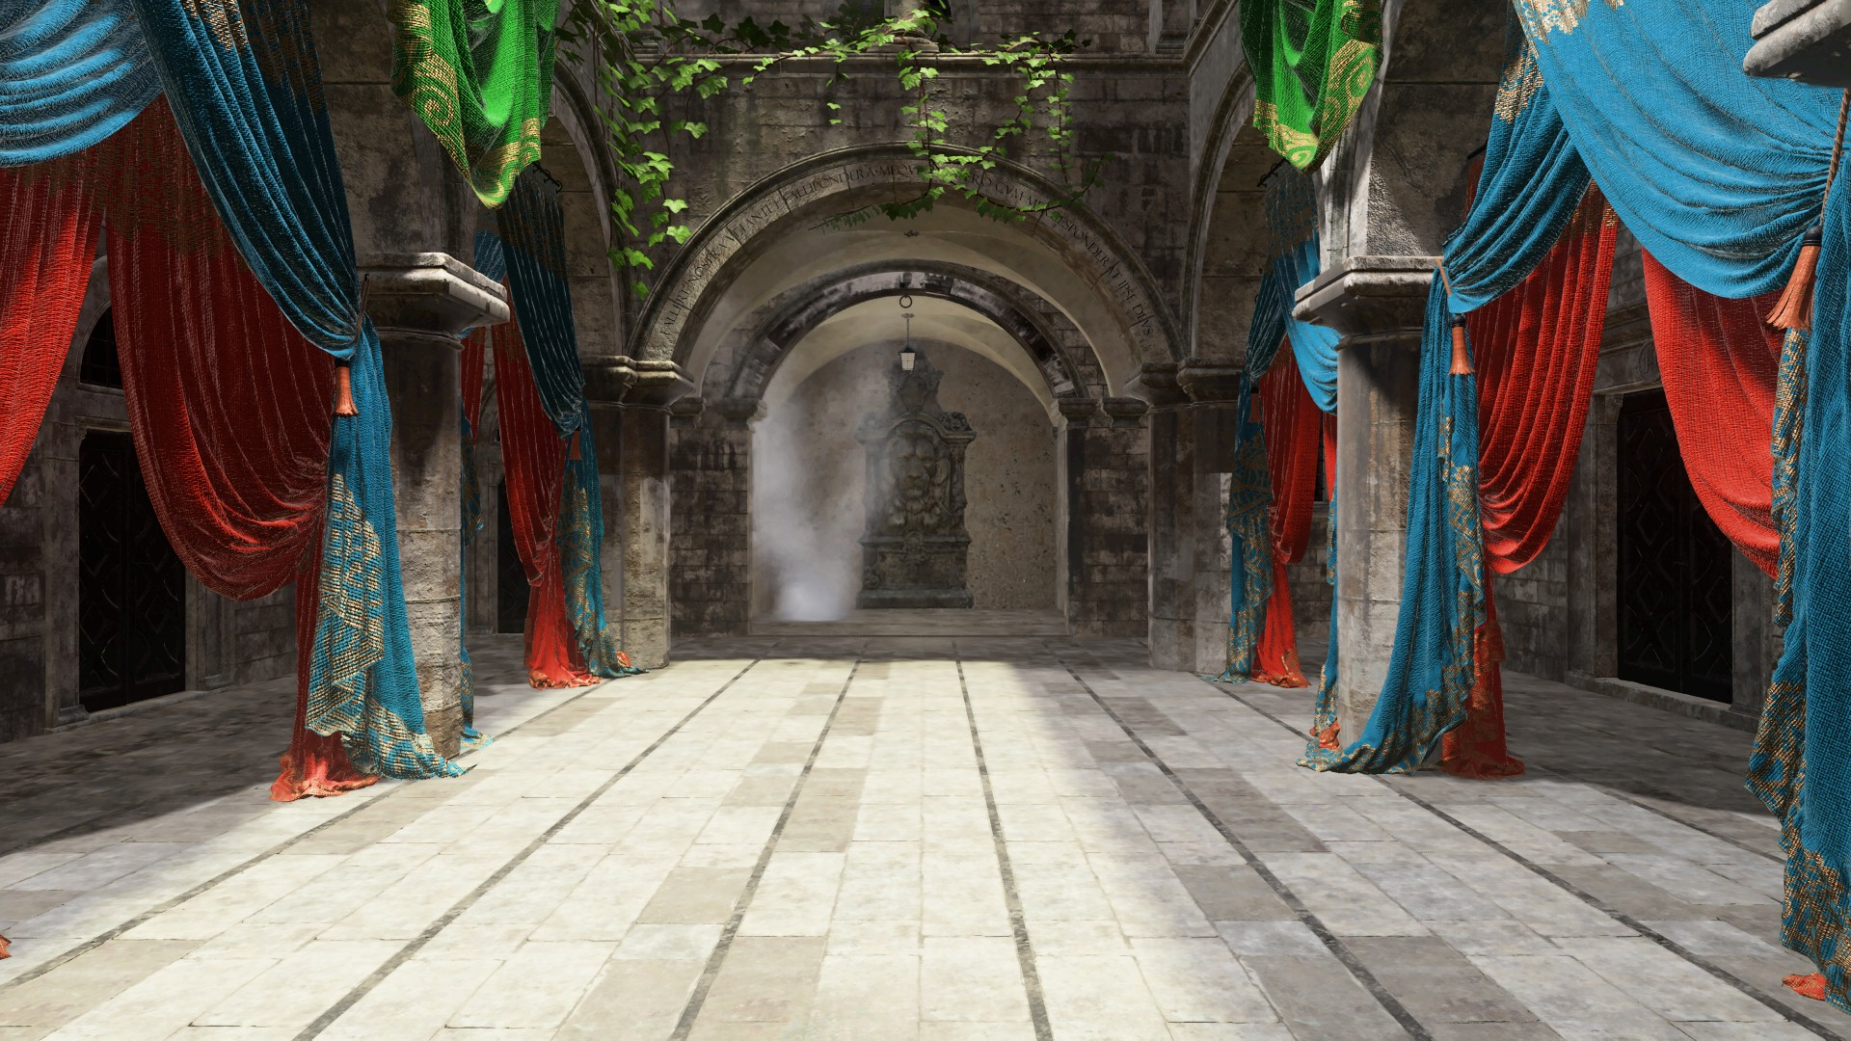
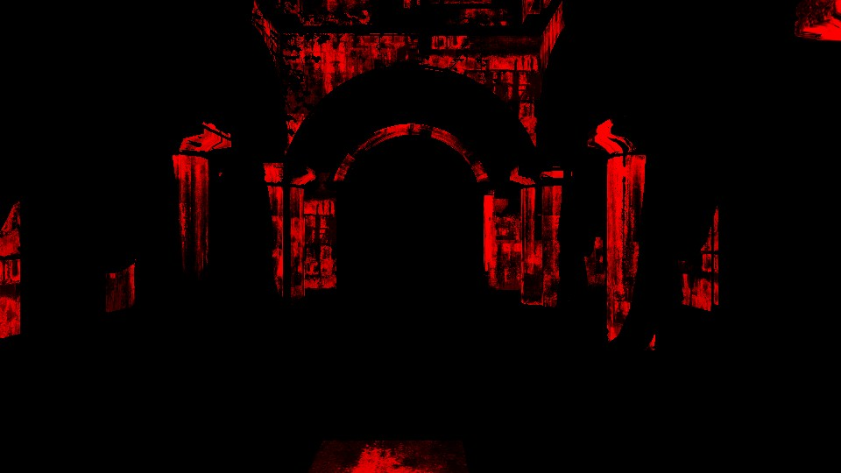
SPECIAL CASES
Certain effects where motion vectors do not match surface color
Reflections, Animated Textures, etc
Locks must be prevented
Explicitly mark such areas in the Transparency & Composition mask.
0 = No modifications to locks, 1 = Locks fully removed

Slide 37
Dynamic resolution scaling
Ability to decrease render resolution on heavy workload still outputting a high-resolution target
Once the load decreases, the render size can be increased again
FSR 2 supports DRS
FSR 2 only relies on render resolution inputs
All persistent data are kept at display resolution
This makes FSR 2 DRS compliant

Slide 38
FSR 2 API
Games
UE Plugin
Common back-end across multiple APIs and platforms
Ease integration – can be ported to other Consoles
API supported
DX12
Vulkan
Microsoft Xbox
Unreal Engine 4.26 & 4.27
Unreal Engine 5
DX11 (available on demand)
FSR 2 API
Sample
Real applications
Real applications
Real applications
Real applications
Real applications
Real applications
XBOX
Sample
Application
FidelityFX API
Backend Interface
XBOX API
DX12 API
Vulkan API
UE RHI API
DX11 API

Slide 39
Shader PERMUTATIONS
Precompiled using ffx-sc
An offline shader permutation builder with DXC, FXC and glslang backends
Takes in a list of defines to generate permutations from
Prevents duplicate permutations
Outputs DXIL/DXBC/SPRIV embedded into C headers
Embedded into the FSR 2 libs
Generates reflection data used for binding resources

Slide 40
Runtime
Permutations selected at runtime based on hardware capabilities and various optimizations
FP16/FP32, Wave32/Wave64, etc
All shading language specifics abstracted
Resource declaration in a separate header
Functions and macros for Math, Wave Intrinsics, etc
Makes porting to new platforms easy
Declare resources and implement the abstracted functions and macros

Slide 41
Integration Process
Games that already support DLSS 2.X
UE4/UE5 titles integrating FSR 2 plugin
Games with support for decoupled display/render resolution
Games without support for decoupled display/render resolution
with TAA support
without TAA support
Quickest (less than 3 days)
Longest (~4 weeks)

Slide 42
Integration Process
Build solution matching your API
Copy the library and headers of the core API and backend into your external libs folder
Allocate scratch buffer for the backend
ffxFsr2GetScratchMemorySizeDX12()
ffxFsr2GetScratchMemorySizeVK()
Create backend
ffxFsr2GetInterfaceDX12()
ffxFsr2GetInterfaceVK()

Slide 43
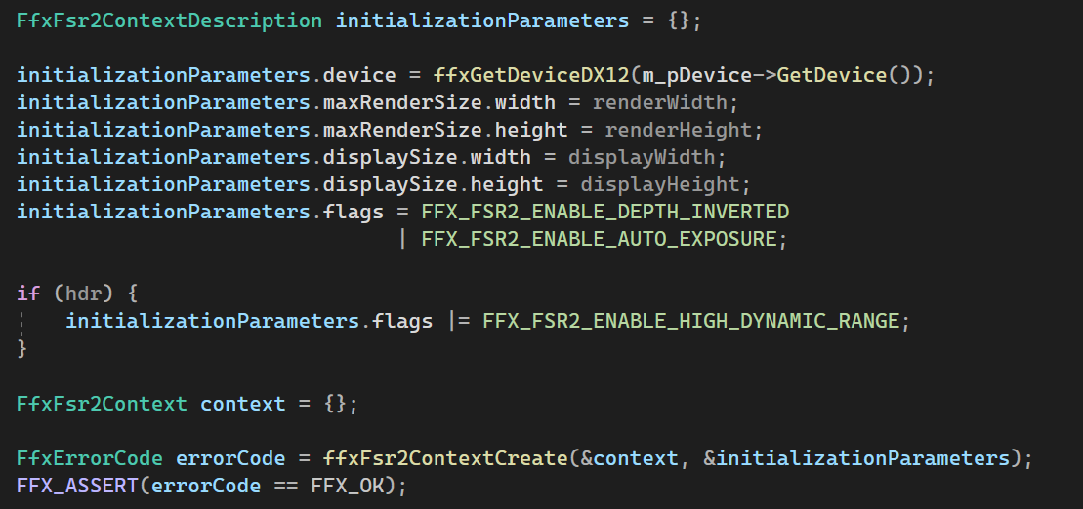
Integration Process
Create FSR 2 context using ffxFsr2ContextCreate()

Slide 44
Integration Process
Apply sub-pixel jittering to your applications projection matrix before scene rendering
Get the offsets using ffxFsr2GetJitterOffset()

Slide 45
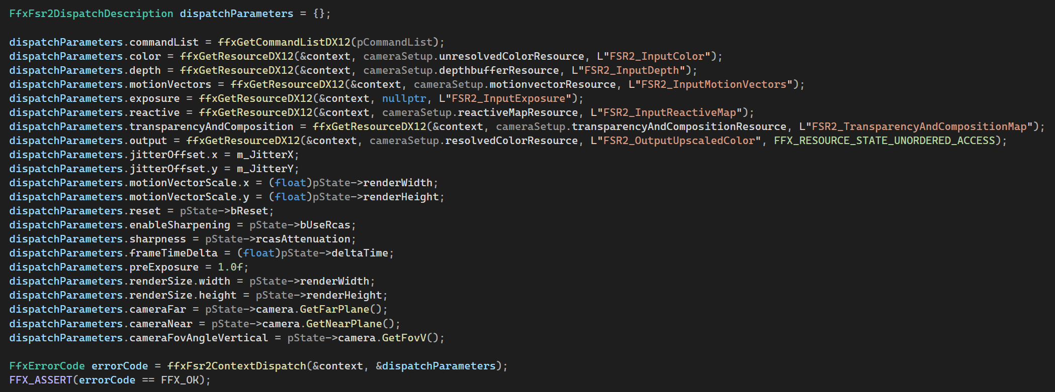
Integration Process
Each frame call ffxFsr2ContextDispatch() to launch FSR2 workloads

Slide 46
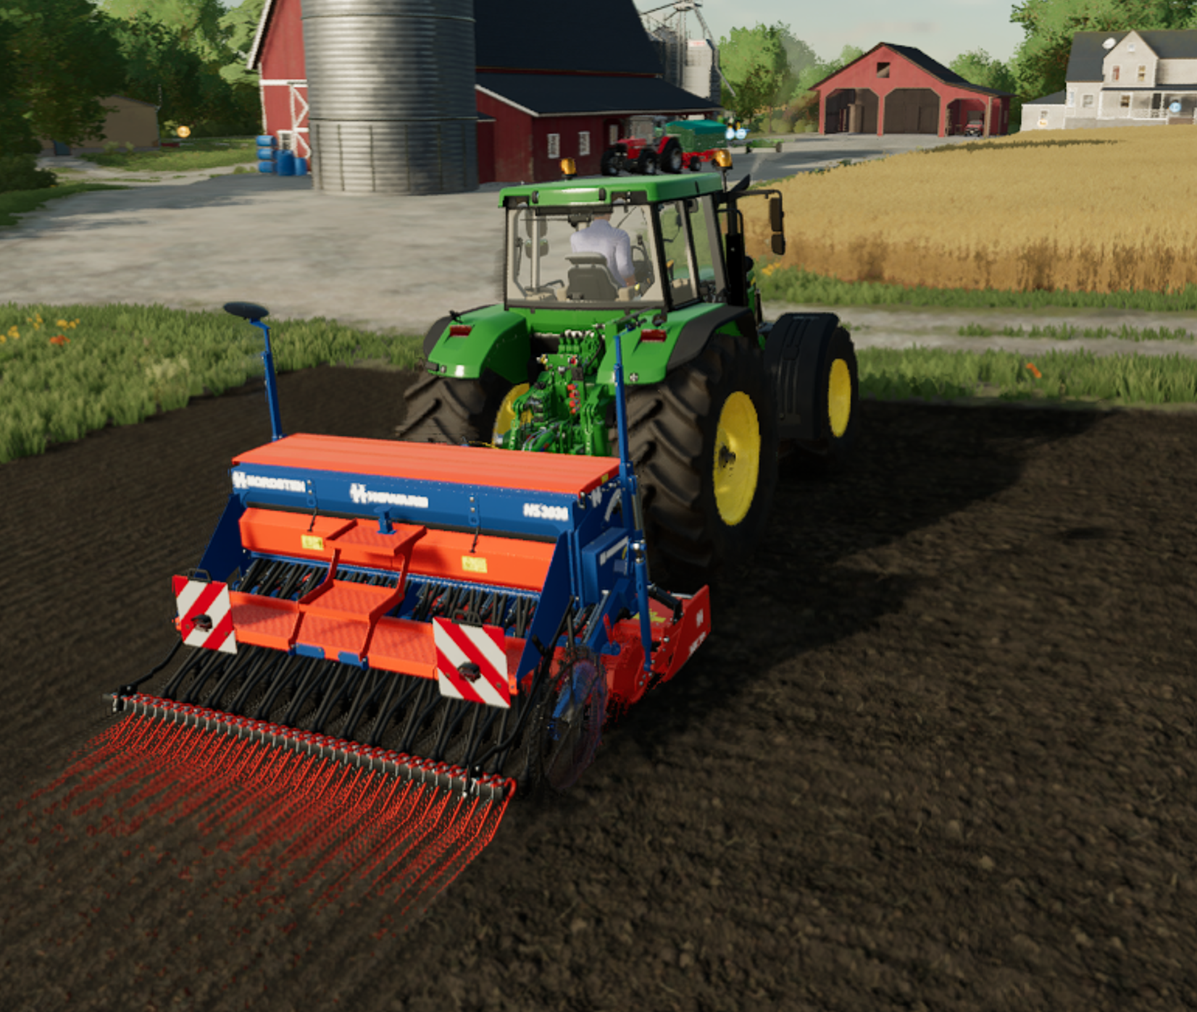
What’s new in FSR 2.1
Updates to the reactive mask
Dilation now based on input colors to avoid expanding of reactiveness into non-relevant areas of the upscaled output
The full data range [0.0, 1.0] is now used
This should alleviate ghosting issues on transparent geometry such as particles
FSR 2.0
FSR 2.1

Slide 47
What’s new in FSR 2.1
Updates to the composition and transparency mask
Dilation now based on input colors to avoid expanding of lock diminishing into non-relevant areas of the upscaled output
This should alleviate ghosting issues on geometry with motion vectors not matching underlying pixel colors
Motion vector divergence used to diminish locked pixels
This should alleviate ghosting issues on geometry with motion vectors not matching underlying pixel colors
Disocclusion logic is now able to detect disocclusions in areas with only small depth separation between objects
This should alleviate ghosting issues and improve upscaling quality on some disocclusion cases (i.e., pixels in an image that don’t have corresponding history)

Slide 48
What’s new in FSR 2.1
Improved upscaled output quality by turning some half-precision computations to full-precision
This should improve overall color range and temporal stability of the upscaled image produced
Performance carefully monitored during this change
Various small bug fixes and documentations fixes
A big thank you to everyone who filed bugs and contributed on GitHub!
This is our goal with GPUOpen releases

Slide 49
Conclusion
Competitive temporal upscaling solution
Hardware independent
Recently updated with version 2.1
Will keep improving over time
Full source code available on GitHub
MIT license
Wide adoption from game developers…

Slide 51
Special thanks
Stefan Petersson
Zhuo Chen
Stephan Hodes
Colin Riley
Mark Satterthwaite
Lou Kramer
Gareth Thomas
Brian Bowman
Jonathan Desroches
Agustin Palacio
Steven Tovey
Nick Thibieroz

Slide 52
Questions?
Dihara.Wijetunga@amd.com

Slide 53
DISCLAIMER & ATTRIBUTES
The information presented in this document is for informational purposes only and may contain technical inaccuracies, omissions, and typographical errors. The information contained herein is subject to change and may be rendered inaccurate for many reasons, including but not limited to product and roadmap changes, component and motherboard version changes, new model and/or product releases, product differences between differing manufacturers, software changes, BIOS flashes, firmware upgrades, or the like. Any computer system has risks of security vulnerabilities that cannot be completely prevented or mitigated. AMD assumes no obligation to update or otherwise correct or revise this information. However, AMD reserves the right to revise this information and to make changes from time to time to the content hereof without obligation of AMD to notify any person of such revisions or changes.​ ​ THIS INFORMATION IS PROVIDED 'AS IS." AMD MAKES NO REPRESENTATIONS OR WARRANTIES WITH RESPECT TO THE CONTENTS HEREOF AND ASSUMES NO RESPONSIBILITY FOR ANY INACCURACIES, ERRORS, OR OMISSIONS THAT MAY APPEAR IN THIS INFORMATION. AMD SPECIFICALLY DISCLAIMS ANY IMPLIED WARRANTIES OF NON-INFRINGEMENT, MERCHANTABILITY, OR FITNESS FOR ANY PARTICULAR PURPOSE. IN NO EVENT WILL AMD BE LIABLE TO ANY PERSON FOR ANY RELIANCE, DIRECT, INDIRECT, SPECIAL, OR OTHER CONSEQUENTIAL DAMAGES ARISING FROM THE USE OF ANY INFORMATION CONTAINED HEREIN, EVEN IF AMD IS EXPRESSLY ADVISED OF THE POSSIBILITY OF SUCH DAMAGES. ​
AMD FidelityFX Super Resolution is available on select games and requires developer integration. See https://www.amd.com/en/technologies/radeon-software-fidelityfx-super-resolution for a list of supported games. AMD FidelityFX Super Resolution is “game dependent” and is supported on the following AMD products: AMD Radeon™ RX 6000, RX 5000, RX 500, RX Vega series graphics cards, RX 480, RX 470, RX 460, and all AMD Ryzen™ processors with Radeon™ graphics if the minimum requirements of the game are met. AMD does not provide technical or warranty support for AMD FidelityFX Super Resolution enablement on other vendor's graphics cards. GD-187.​
© 2022 Advanced Micro Devices, Inc. All rights reserved. AMD, the AMD Arrow logo, EPYC, FidelityFX, Infinity Cache, Radeon, RDNA, Ryzen, and combinations thereof are trademarks of Advanced Micro Devices, Inc. Other product names used in this publication are for identification purposes only and may be trademarks of their respective owners. DirectX is either a registered trademark or trademark of Microsoft Corporation in the US and/or other countries. Vulkan and the Vulkan logo are registered trademarks of the Khronos Group Inc. Xbox is a registered trademark of Microsoft Corporation in the US and/or Other countries.​

